Slide 1
Transit Networking
ACE Technical Team

Slide 2
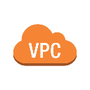








MCNA Deployment: the Foundations
APPLICATIONS LAYER
CORE
LAYER
Spoke VPC 1
Spoke VPC 2
Spoke VNet 1
Spoke VNet 2
Spoke VPC 1
Spoke VPC 2
TRANSIT LAYER
Transit VNet
OPERATIONS
Transit VPC
Transit VPC
ACCESS LAYER
BRANCH
OFFICES
ON-PREM
DATA CENTER
Vendors/Partners
REMOTE
USER
INTERNET
IoT
AWS
Azure
GCP

Slide 3
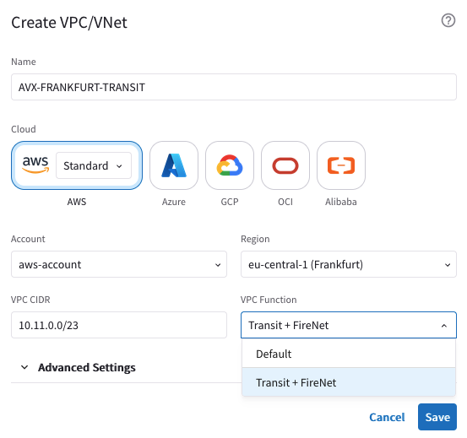
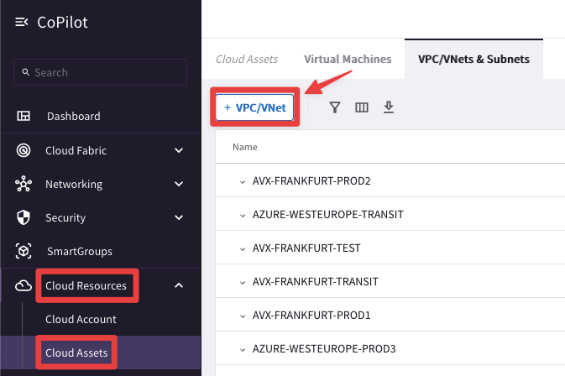
Create VPC/VNet
CLOUD ASSETS
On the CoPilot you can create a new VPC/VNet/VCN.
This feature is not only useful in a Greenfield deployment, but also if you need to add a new VPC/VNet/VCN on an existing environment, based on the architecture design.
You can create two types of VPC/VNet/VCN:
Default (i.e. Spoke)
Transit + FireNet

Slide 4
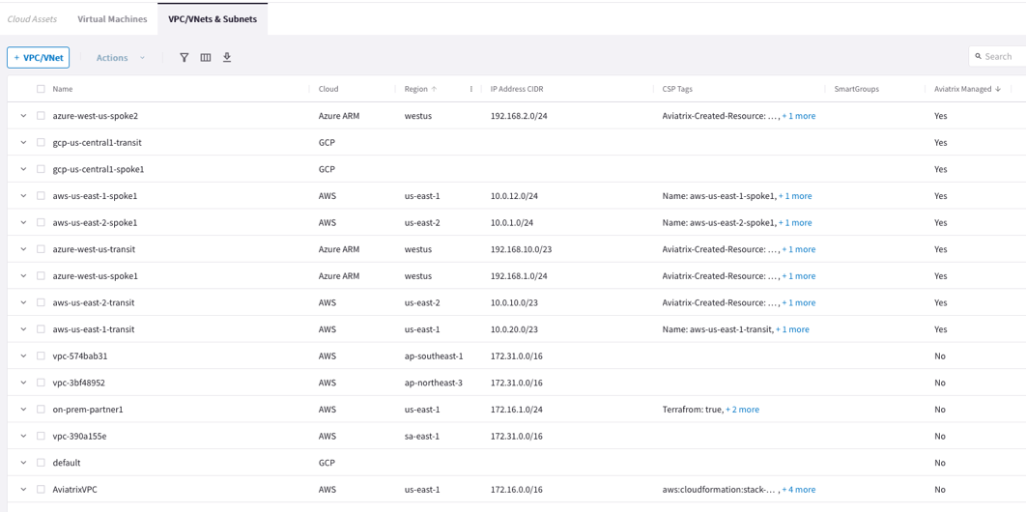
Cloud Assets: Managed VPC vs. Unmanaged VPC
CoPilot shows VPC/VNets that were created in the CSP environment as well as those that were created as part of deploying Aviatrix resources such as those created during the deployment of your Controller, CoPilot, and gateways.
A VPC/VNet can be marked as Aviatrix managed where:
Aviatrix Managed = Yes — Indicates an Aviatrix gateway is running in the VPC/VNet.
Aviatrix Managed = No — Indicates no Aviatrix gateways exist in the VPC/VNet.
Note: If you create a VPC/Vnet by using cloud provider tools ineast of Aviatrix tools (i.e. CoPilot UI), the VPC/Vnet will be marked as unmanaged even if an Aviatrix gateway is running in it

Slide 5
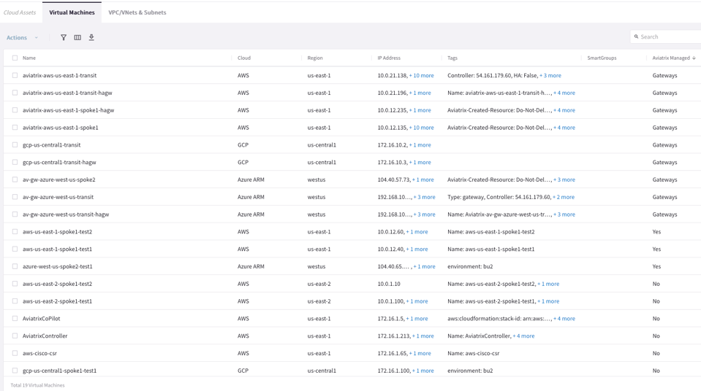
Cloud Assets: Viewing virtual machines running in your Clouds
CoPilot shows in a central location all the virtual machines running in your clouds for cloud accounts onboarded onto Aviatrix Controller.
A VM can be marked as Aviatrix managed where:
Aviatrix Managed = Yes — Indicates the VM is behind an Aviatrix Gateway; that is running in a VPC/VNet where an Aviatrix gateway is deployed.
Aviatrix Managed = No — Indicates the VM is running in a VPC/VNet where no Aviatrix gateways exist.
Aviatrix Managed = Gateways — Indicates the VM is running an Aviatrix Gateway (Transit, Spoke, or Specialty/Other)

Slide 6
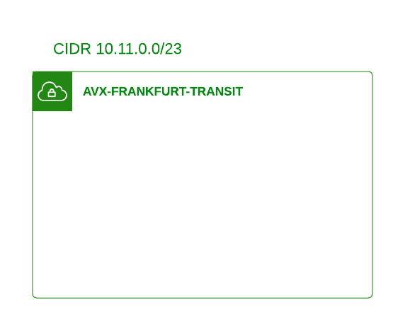
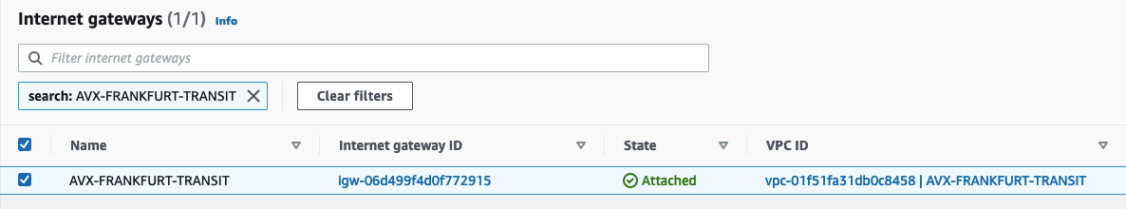
Greenfield Deployment (VPC/VNet/VCN creation)
Caveat: for the sake of simplicity, only the deployment in AWS is explained
Creation of the Transit VPC
The VPC CIDR range for a Transit VPC is from /16 to /23
There is a specific reason why the Aviatrix Controller does not allow less than /23 prefix length for the Transit VPC (this will be discussed on the HPE lecture).
An IGW with the same name of the Transit VPC will be created and attached to the VPC, automatically

Slide 7
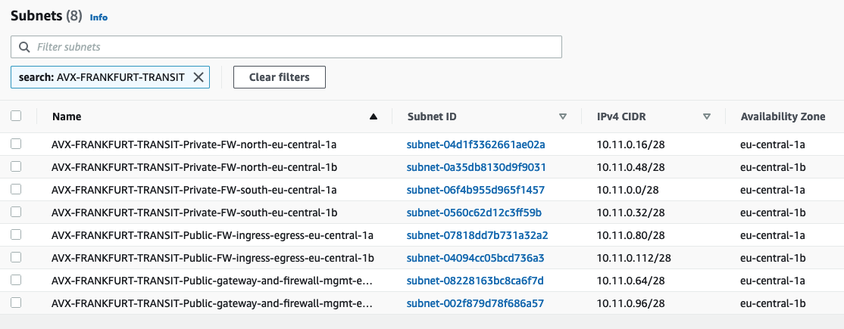
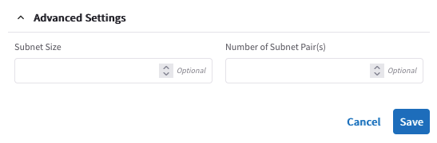
Greenfield Deployment (VPC/VNet/VCN creation)
Creation of the Transit VPC
The Aviatrix Controller will create 8 subnets, in two availability zones:
4x Private subnets for the FW
2x Public subnets for Ingress-Egress
2x Public subnets for GW-FW-mgmt.
All the subnets will have a /28 prefix length
The subnets’ size can be customized
Aviatrix Transit VPC – Aviatrix Official Documentation

Slide 8


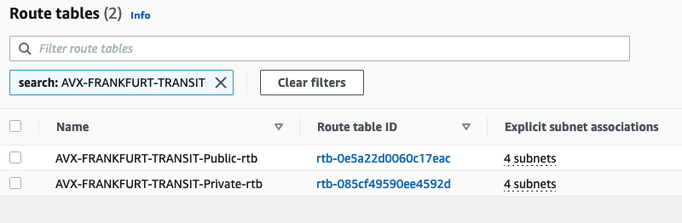
Greenfield Deployment (VPC/VNet/VCN creation)
Creation of the Transit VPC
2x Routing Tables will be created:
Public RTB will encompass the 4 public subnets
Private RTB will encompass the 4 private subnets

Slide 9
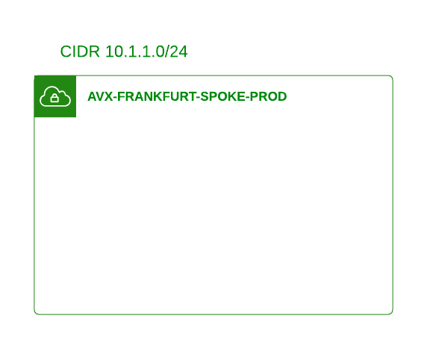
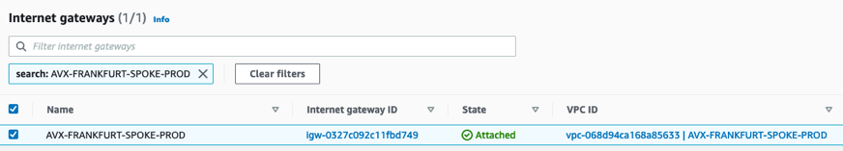
Greenfield Deployment (VPC/VNet/VCN creation)
Creation of the Application/Spoke VPC
The VPC CIDR range for a Spoke VPC is from /16 to /24
An IGW with the same name of the Spoke VPC will be created and attached to the VPC, automatically

Slide 10
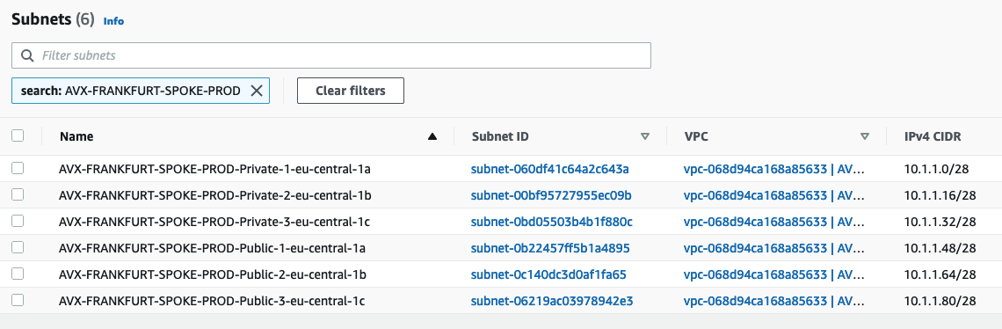
Greenfield Deployment (VPC/VNet/VCN creation)
Creation of the Application/Spoke VPC
The Aviatrix Controller will create a pair of subnets, a public subnet and a private subnet, on each availability zone
All the subnets will have a /28 prefix length
The subnets’ size can be customized
Aviatrix Spoke VPC – Aviatrix Official Documentation

Slide 11


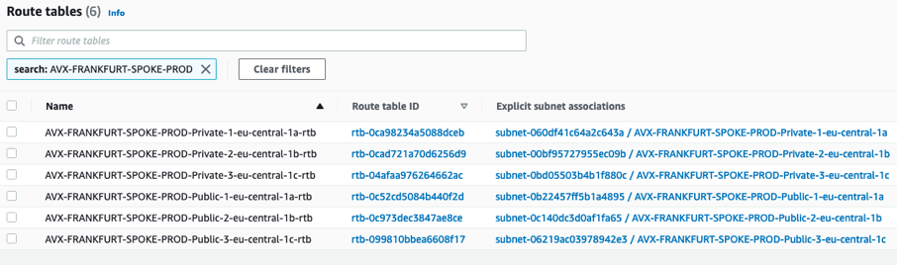
Greenfield Deployment (VPC/VNet/VCN creation)
Creation of the Application/Spoke VPC
a Public RTB per each availability zone will encompass the corresponding subnet
a Private RTB per each availability zone will encompass the corresponding subnet

Slide 12
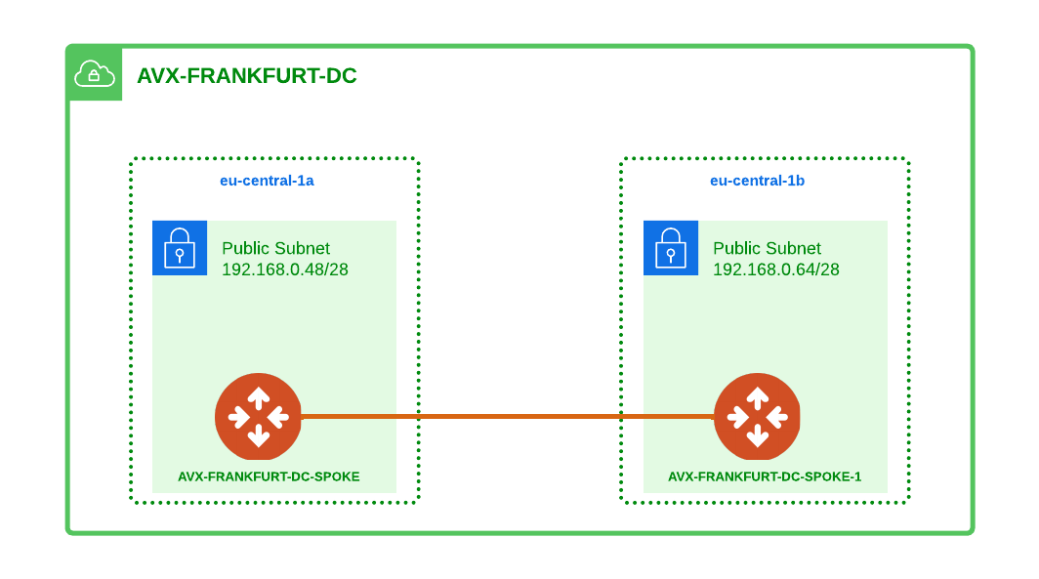
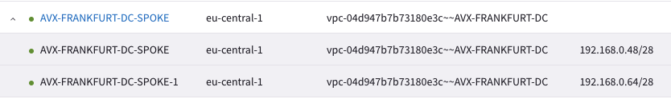
Name Convention with Multiple Gateways
Cluster of Gateways
If you create two or more Gateways, they will be encompassed inside a cluster.
The name of the cluster will match the name of the first gateway.
The second gateway will have the string “-1” appended to its name.
The third gateway will have the string “-2” appended to its name.
.
.
.
The fifteenth gateway will have the string “-14” appended to its name.
CLUSTER
GW #1
GW #2

Slide 13
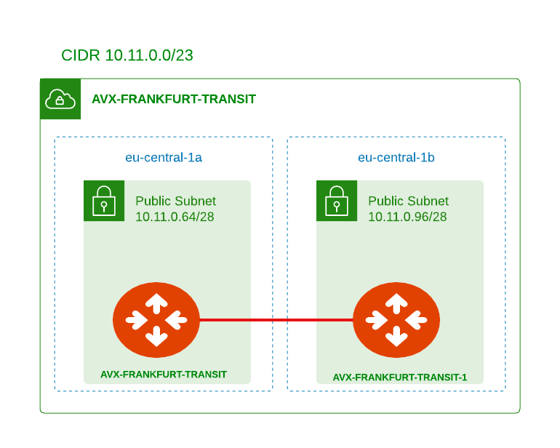
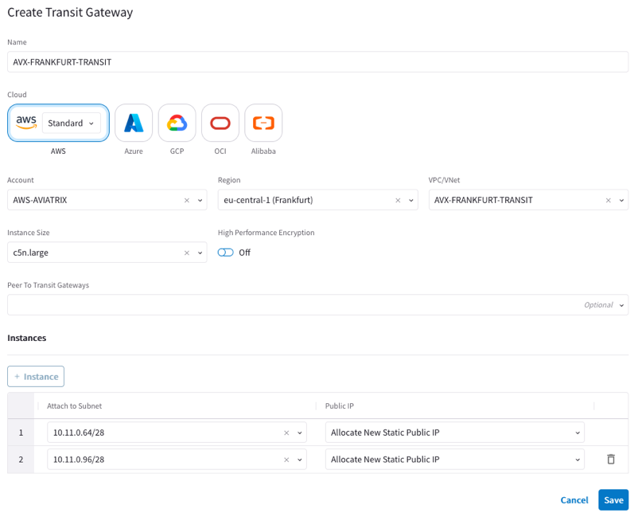
Greenfield Deployment (Transit Gateways deployment)
Transit Gateways Deployment through the CoPilot
The connection between the Transit Gateways is automatically created by the Controller.
Best Practice: always deploy the Transit Gateway-1 (i.e the second gateway), and choose a different AZ.
Only two Transit Gateways can be deployed per Transit VPC
Aviatrix gateways are deployed in Public subnets

Slide 14
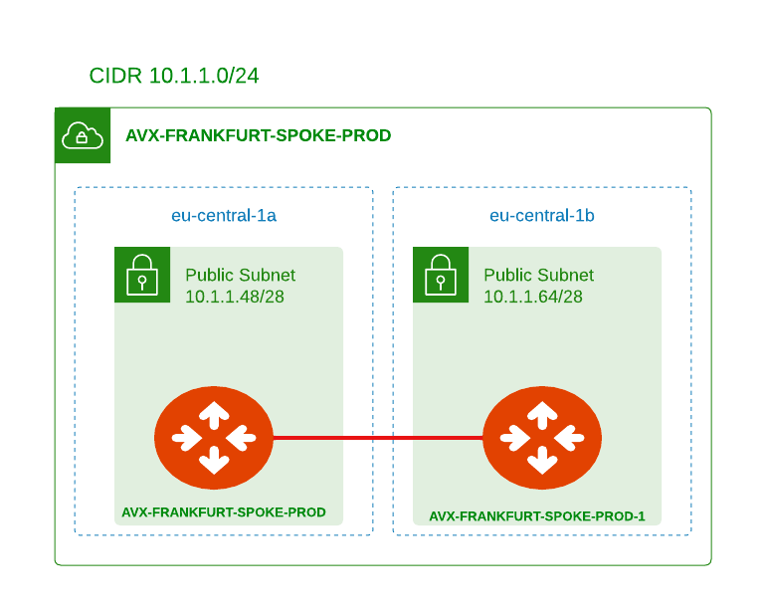
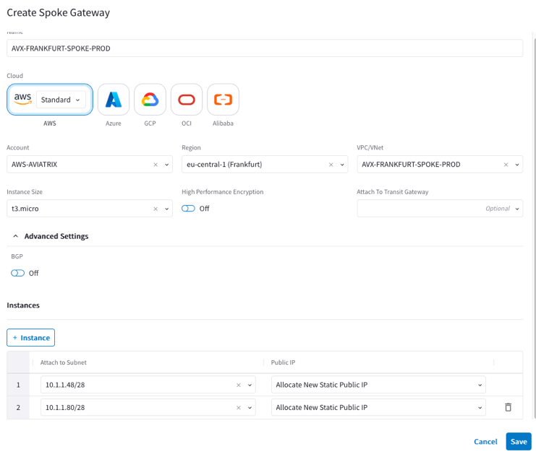
Greenfield Deployment (Spoke Gateways deployment)
Spoke Gateways Deployment through the CoPilot
The connection between the Spoke Gateways is automatically created by the Controller.
Best Practice: deploy the Spoke Gateway-1 (i.e the second gateway) on a different AZ.
You can deploy up to 15 Spoke Gateways per each Spoke VPC
Aviatrix gateways are deployed in Public subnets

Slide 15
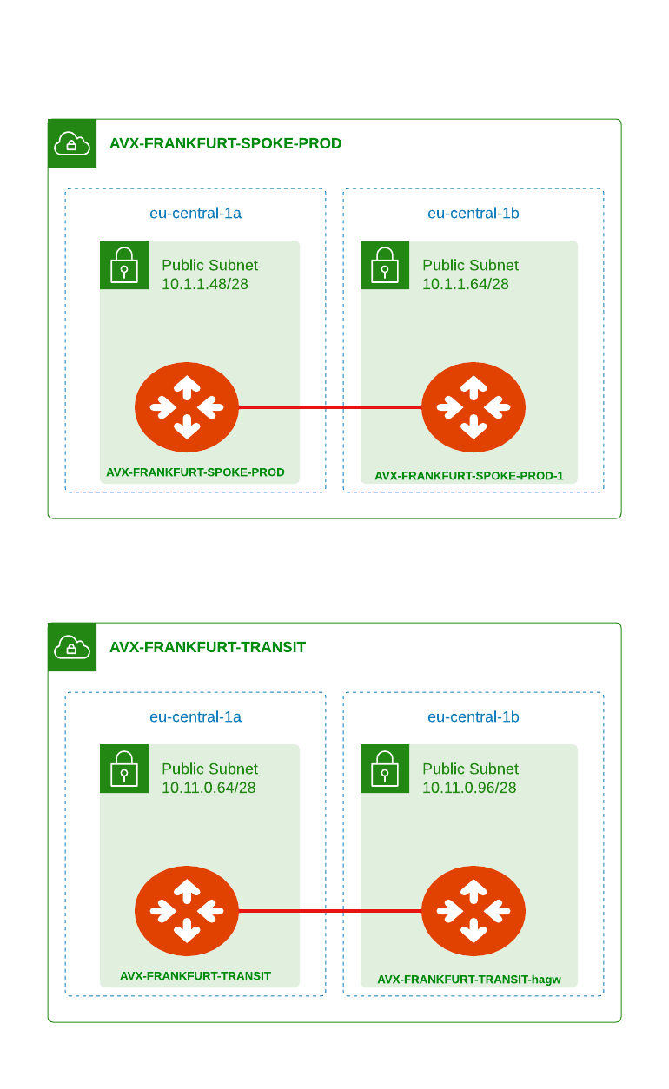
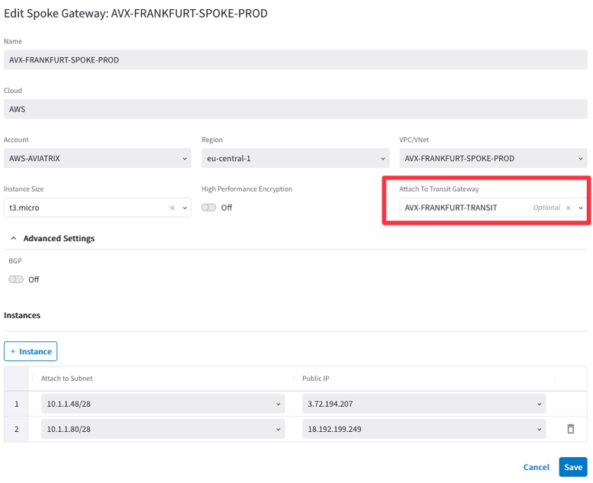
Greenfield Deployment (Attachment deployment)
Deployment of the attachments through the CoPilot

Slide 16
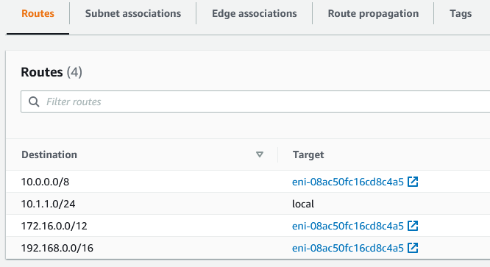
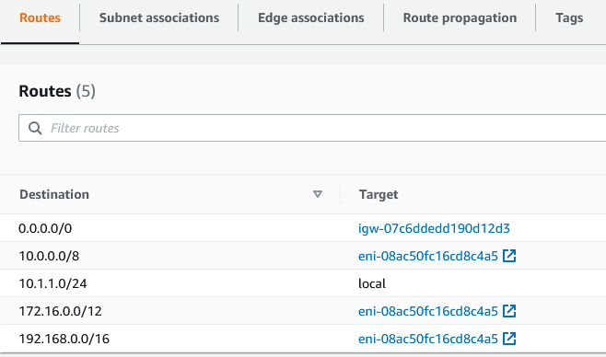
Greenfield Deployment (Attachment deployment)
As soon as the Controller completes the deployment of the attachments between Spoke Gateways and Transit Gateways, it will also program the three RFC1918 routes in the route tables to point to the ENI of the Spoke Gateways.
Attachment = RFC1918 Routes Injection
APPLICATIONS LAYER
Spoke VPC 1
Spoke VPC 2
Route table for Private Subnet
Route table for Public Subnet
Transit VPC
OPERATIONS

Slide 17
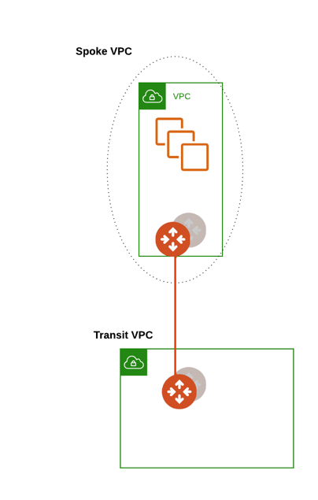
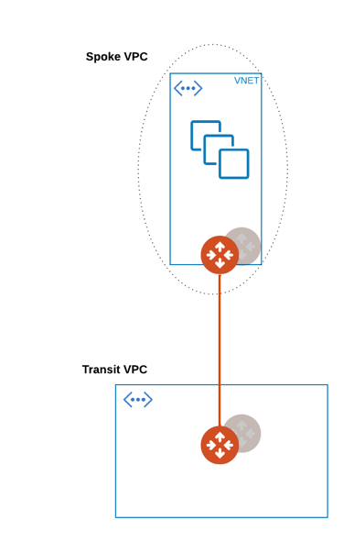
Greenfield Deployment (Repeatable Design)
The hub and spoke topology can be extended to another CSP or to another region within the same CSP
In Azure all subnets are public by nature
Aviatrix Controller creates “Private” subnets:
Aviatrix Controller programs a default route 0.0.0.0 pointing to the next hop type “None”: in User Defined Route Table (UDR) for all private subnets it creates
This will blackhole 0/0 traffic

Slide 18
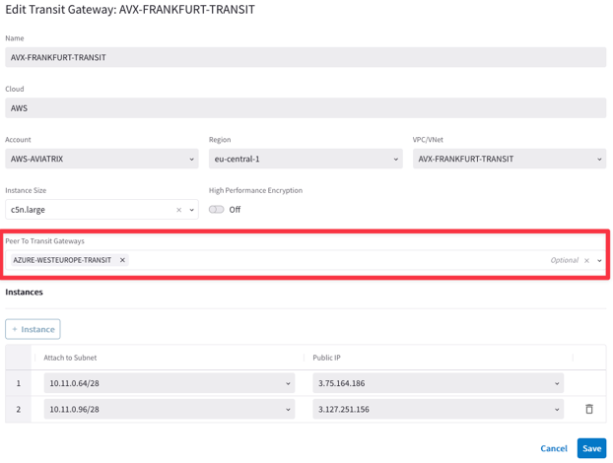
Greenfield Deployment (Peering deployment)
The creation of the Transit Peering represents the last step for the completion of the MCNA.

Slide 19
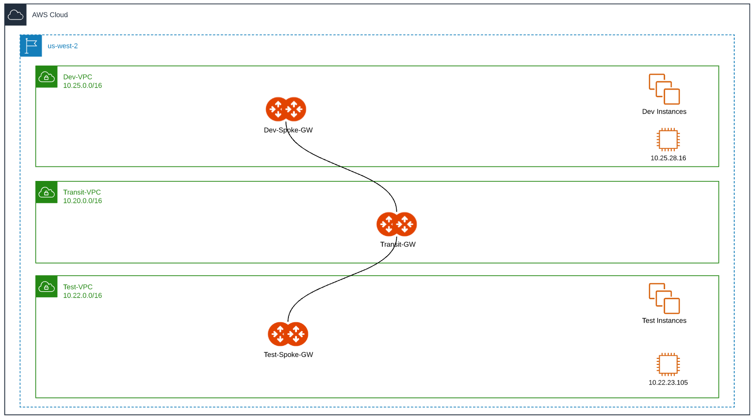
Packet Walk
Dev-VPC route table (underlay)
Destination | Target
10.0.0.0/8 | ENI of Dev-Spoke-GW
1
Src IP = 10.25.28.16 | Dst IP = 10.22.23.105
Private IP: 10.25.81.91 Public IP: 52.88.117.172
Dev-Spoke-GW route table (overlay)
Destination | Target
10.22.0.0/16 | Encap to 35.155.31.81 (Transit-GW)
Outer Src IP = 52.88.117.172 | Outer Dst IP = 35.155.31.81
Inner Src IP = 10.25.28.16 | Inner Dst IP = 10.22.23.105
Encap
2
Aviatrix Transit-GW route table
Internal decap
3
Destination | Target
10.22.0.0/16 | Encap to 54.184.119.18 (Test-Spoke-GW)
Public IP: 35.155.31.81
Outer Src IP = 35.155.31.81 | Outer Dst IP = 54.184.119.18
Inner Src IP = 10.25.28.16 | Inner Dst IP = 10.22.23.105
4
Encap
Test-Spoke-GW route table
Src IP = 10.25.28.16 | Dst IP = 10.22.23.105
Decap
5
Destination | Target
10.22.0.0/16 | Decap to eth0 (VPC underlay)
Test-VPC route table
Private IP: 10.22.80.154
Public IP: 54.184.119.18
Destination | Target
10.22.0.0/16 | Local
18

Slide 20

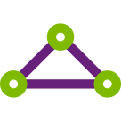

Advanced Transit Networking
AWS to on-Prem via ExpressRoute or vice versa
AZSC-Spoke-1
AZSC-Spoke-2
OR-Spoke-1
OR-Spoke-3
OR-SS
Single DX or ER can be used to communicate between On-Prem and multiple CSP resources
172.16.6.20
172.16.7.20
10.150.89.134
10.152.24.64
10.154.90.201
AZSC-Transit
OR-Transit
65020
65013
172.16.10.0/16
10.160.0.0/16
Equinix
65050
10.200.0.0/23
ON-PREM
DATA CENTER

Slide 21
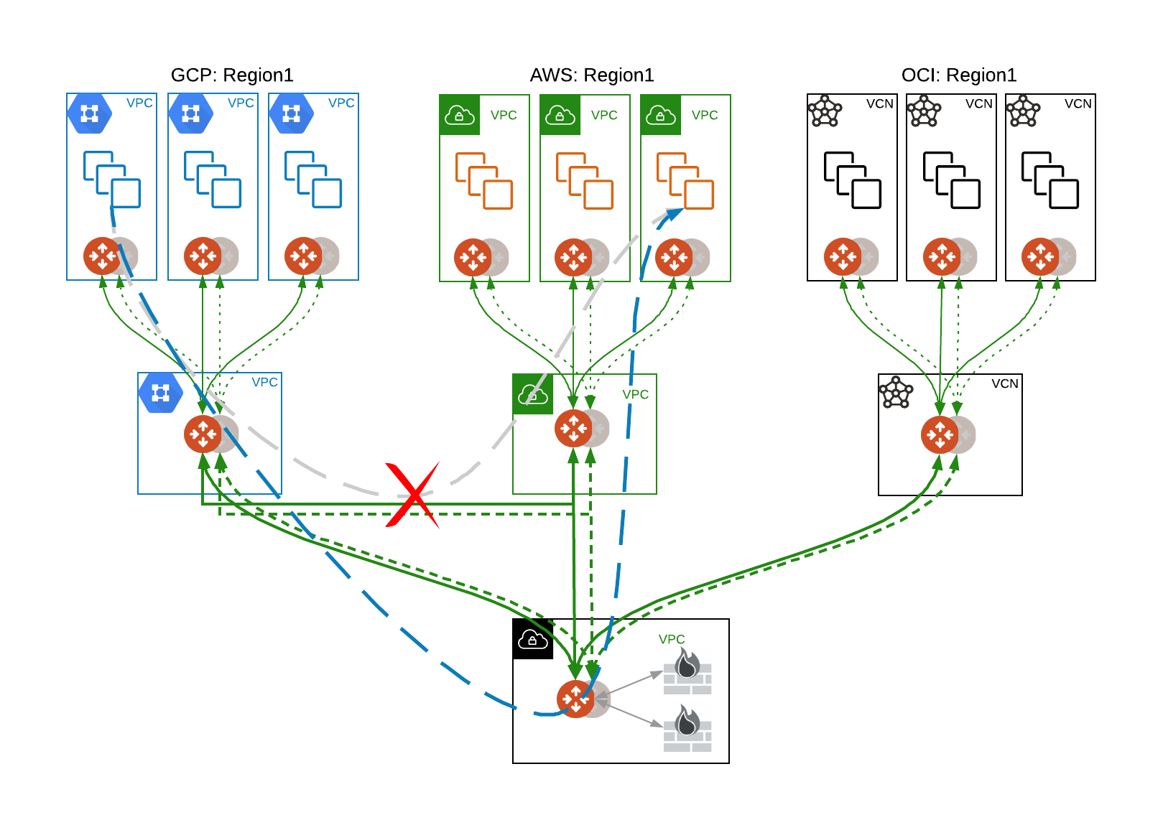
Multi-Tier Transit (MTT)
Improves operational simplicity by aggregating multiple Aviatrix Transits (no need for full mesh between transits)
Additional failover option (pictured in the diagram)
Allows for centralized firewall design for multiple Aviatrix-Transits in a single region, which allows intra-cloud traffic without any inspection
To configure Multi-Tier Transit, go to Multi-cloud Transit -> Advanced Config. Select the Transit Gateway and enable the Multi-Tier Transit feature

Slide 22
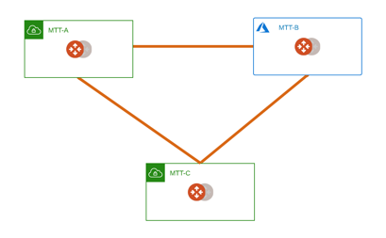
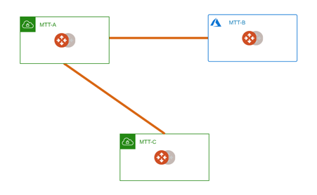
MTT: Route Propagation Logic
MTT propagation logic:
MTT will propagate peering routes to other peering if the peer where the routes it receives from and the peer where it target to send do not have transit peering.
Notes: when all tunnels for a transit peering goes down, routes will be removed, and routes will be added when first tunnel goes up.
MTT A<->B, A<->C.
if B<->C goes up, A will delete propagate B's peering routes from C and to C.
MTT A<->B, A<->C, B<->C, A does not propagate B's peering routes to C.
MTT A<->B, A<->C, B is not peering with C, A propagate B's peering routes to C.

Slide 23
Next: Lab 2 – (MCNA) Transit Networking

